Slide 1

Ray: Distributed Systems and AI
A general-purpose system for parallel and distributed Python
https://github.com/ray-project/ray
Robert Nishihara

Slide 2

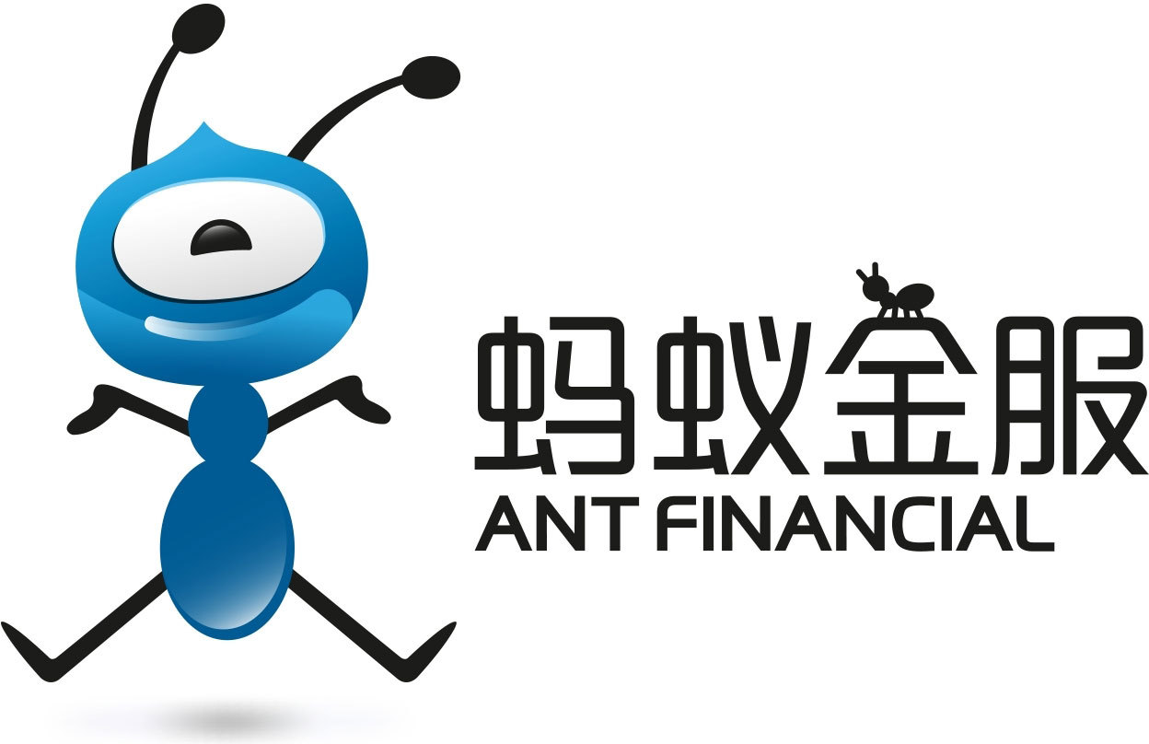









A Growing Number of Use Cases

Slide 3
The Machine Learning Ecosystem
Machine Learning Ecosystem

Slide 4
The Machine Learning Ecosystem
Machine Learning Ecosystem
Training

Slide 5
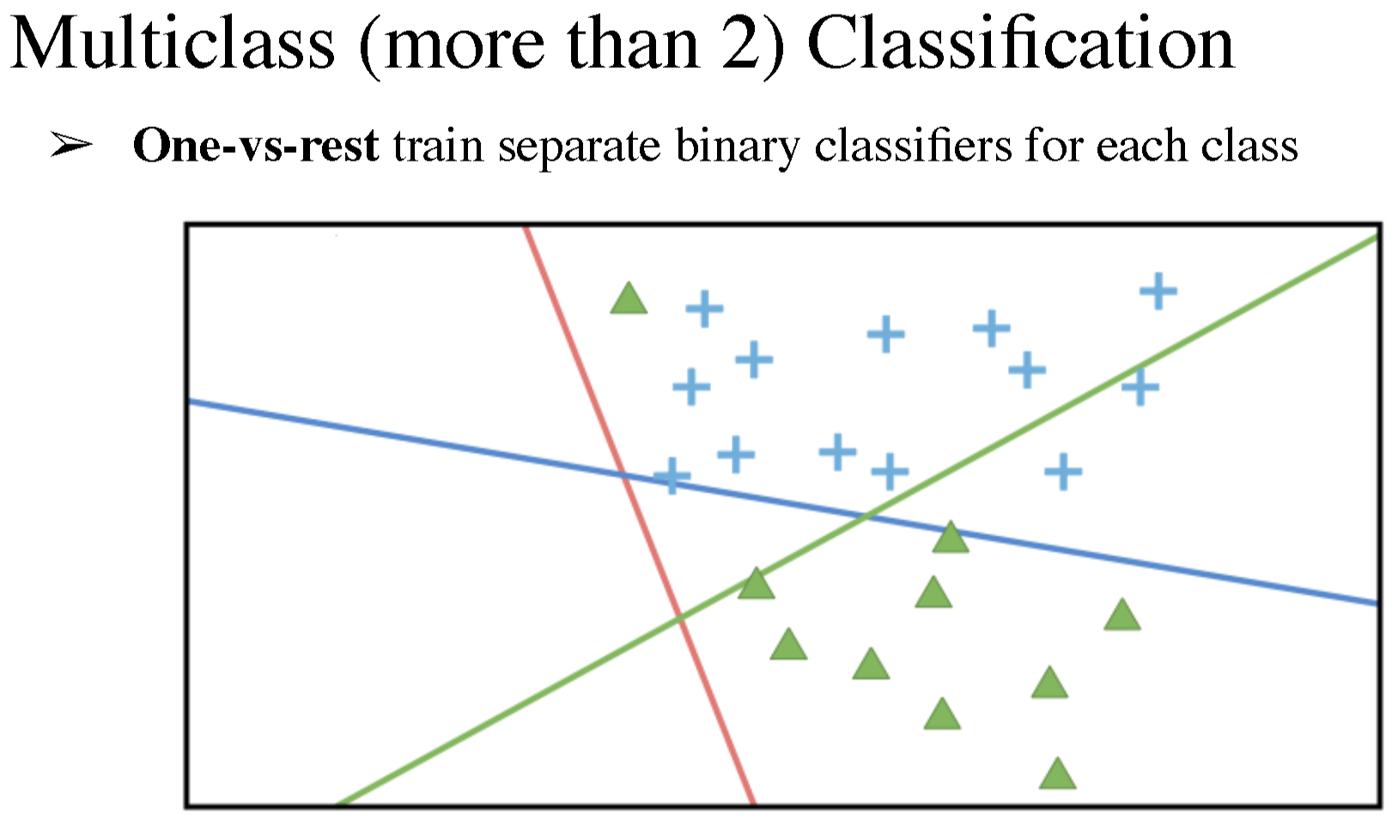
The Machine Learning Ecosystem
Machine Learning Ecosystem
Training

Slide 6
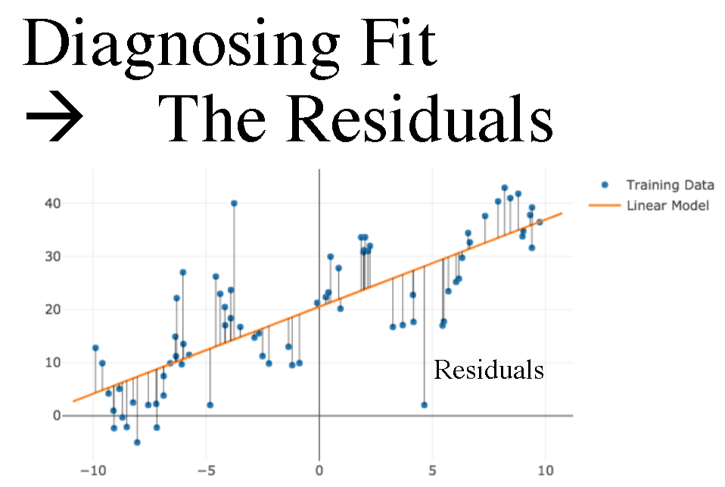
The Machine Learning Ecosystem
Machine Learning Ecosystem
Training

Slide 7
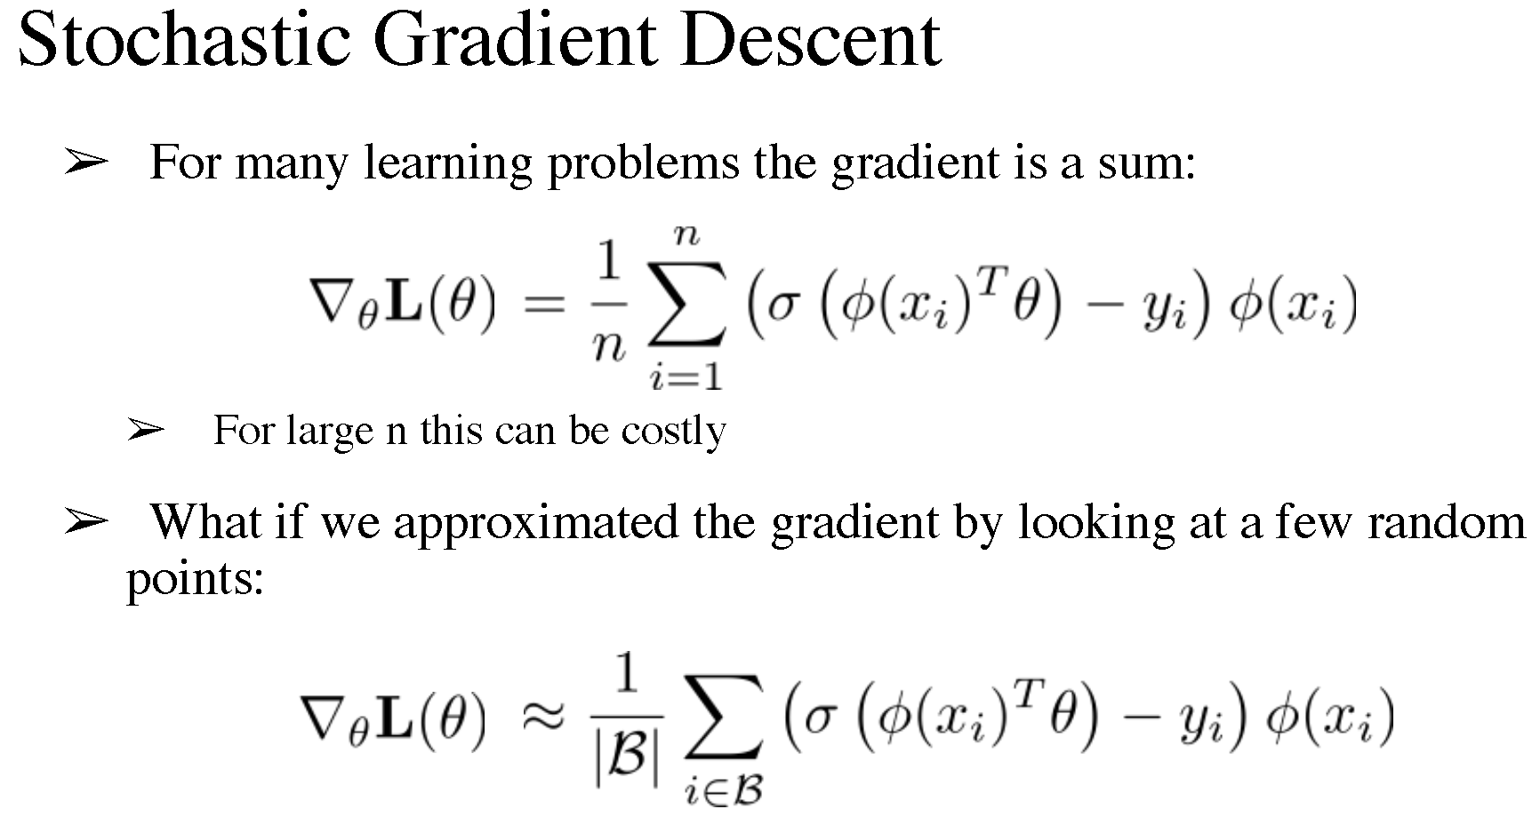
The Machine Learning Ecosystem
Machine Learning Ecosystem
Training

Slide 8
The Machine Learning Ecosystem
Machine Learning Ecosystem
Training
RL

Slide 9
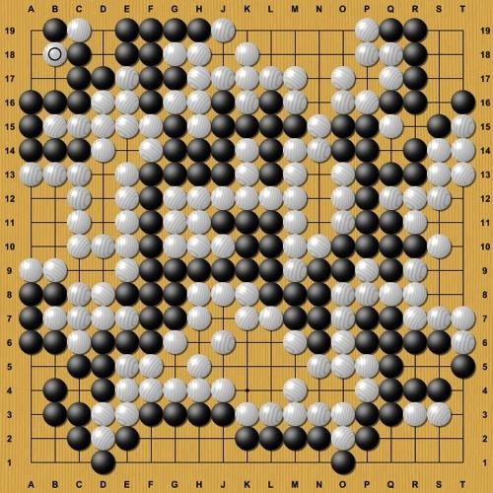
The Machine Learning Ecosystem
Machine Learning Ecosystem
Training
RL

Slide 10
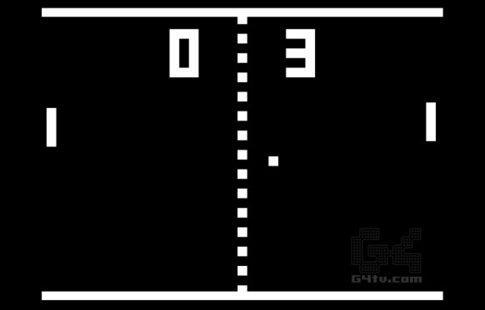
The Machine Learning Ecosystem
Machine Learning Ecosystem
Training
RL

Slide 11
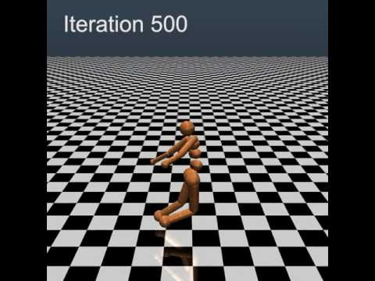
The Machine Learning Ecosystem
Machine Learning Ecosystem
Training
RL

Slide 12

The Machine Learning Ecosystem
Machine Learning Ecosystem
Training
RL

Slide 13
The Machine Learning Ecosystem
Machine Learning Ecosystem
Training
Model Serving
RL

Slide 14
The Machine Learning Ecosystem
Machine Learning Ecosystem
Training
Model Serving
RL
Hyperparameter Search

Slide 15
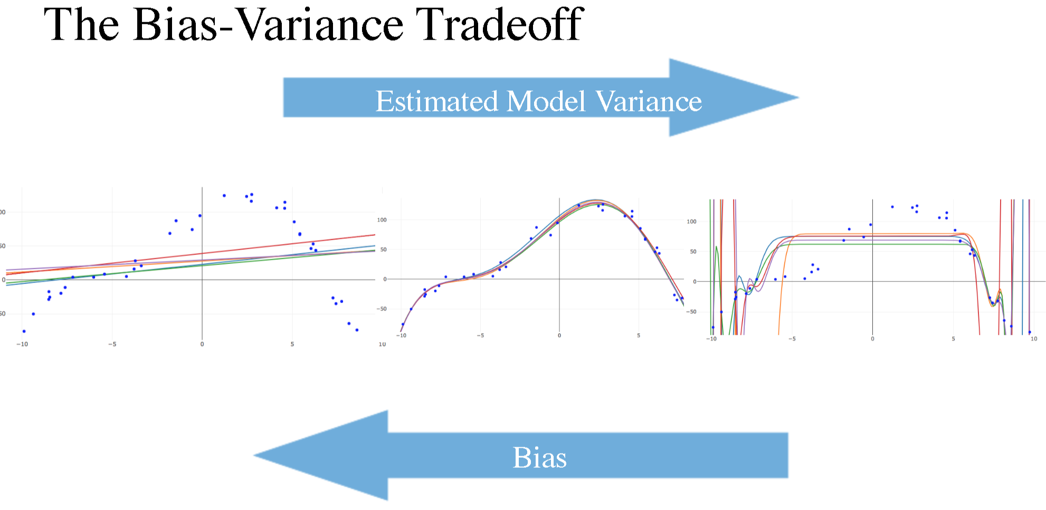
The Machine Learning Ecosystem
Machine Learning Ecosystem
Training
Model Serving
RL
Hyperparameter Search

Slide 16
The Machine Learning Ecosystem
Machine Learning Ecosystem
Training
Model Serving
RL
Data Processing
Hyperparameter Search

Slide 17
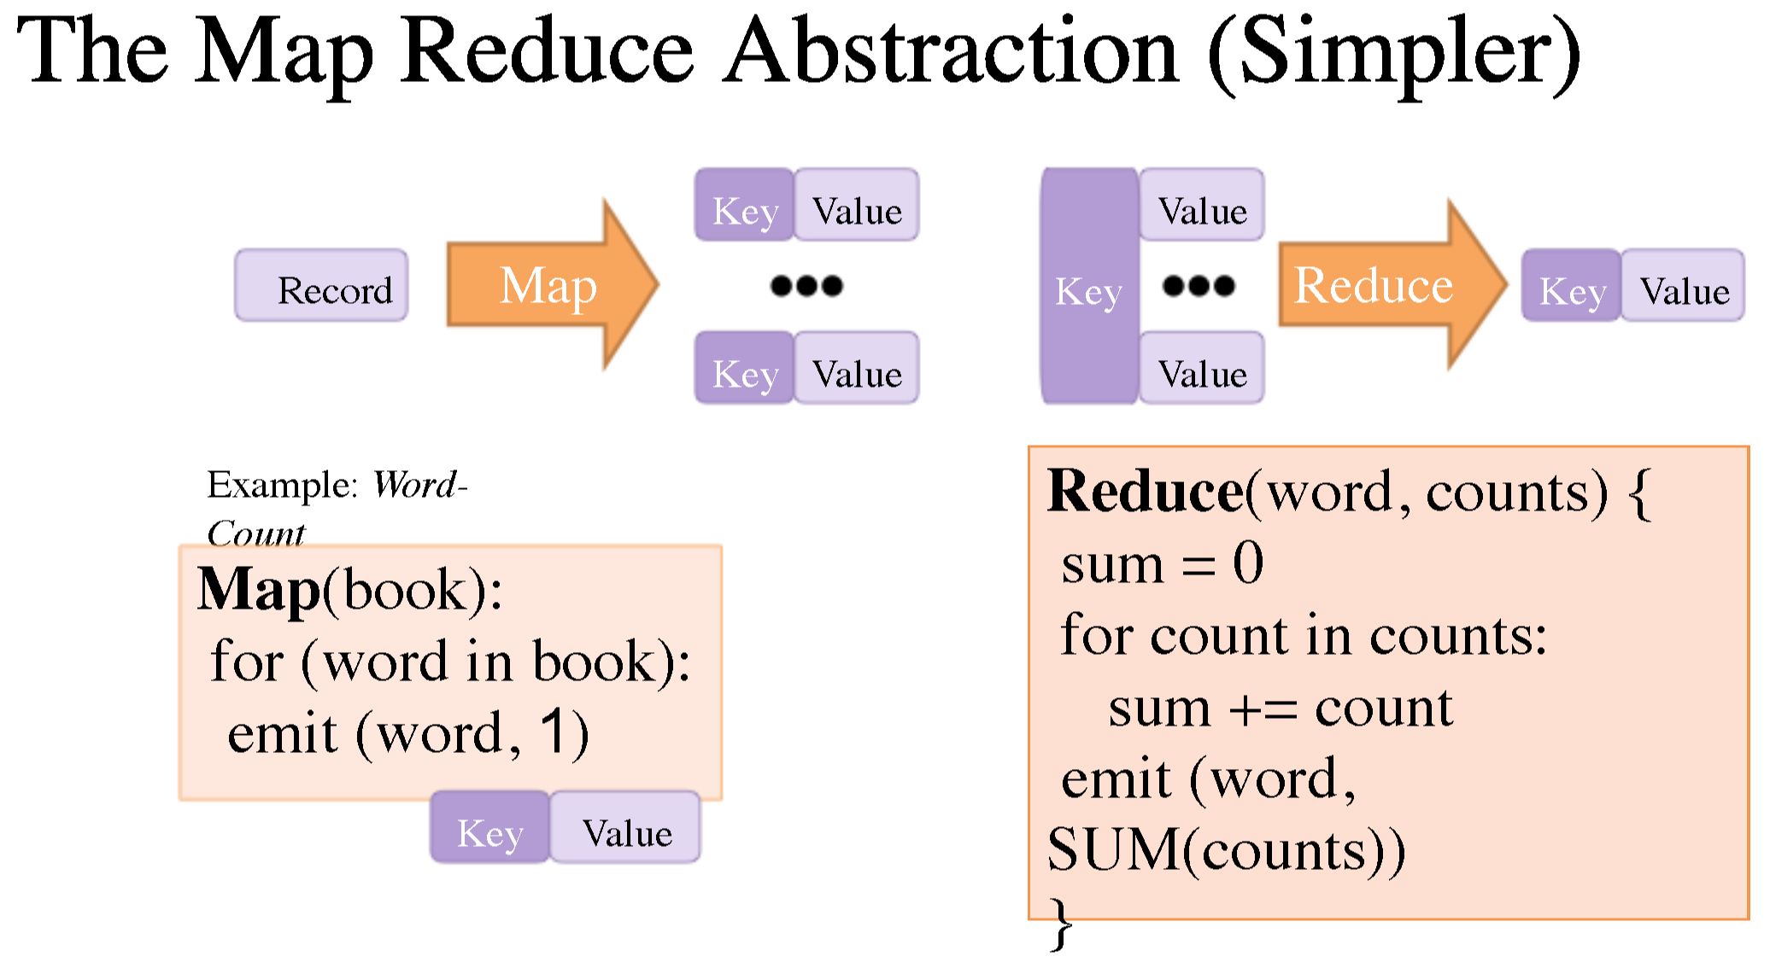
The Machine Learning Ecosystem
Machine Learning Ecosystem
Training
Model Serving
RL
Data Processing
Hyperparameter Search

Slide 18
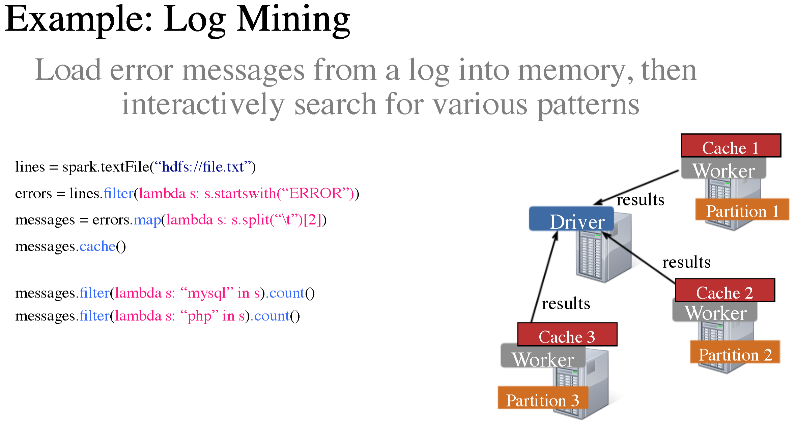
The Machine Learning Ecosystem
Machine Learning Ecosystem
Training
Model Serving
RL
Data Processing
Hyperparameter Search

Slide 19
The Machine Learning Ecosystem
Machine Learning Ecosystem
Training
Model Serving
Streaming
RL
Data Processing
Hyperparameter Search

Slide 20
The Machine Learning Ecosystem
Machine Learning Ecosystem
Distributed
System
Distributed System
Distributed System
Distributed System
Distributed System
Distributed System
Training
Model Serving
Streaming
RL
Data Processing
Hyperparameter Search

Slide 21
The Machine Learning Ecosystem
Machine Learning Ecosystem
Distributed System
Distributed System
Distributed System
Distributed System
Distributed System
Distributed System
Training
Model Serving
Streaming
RL
Data Processing
Hyperparameter Search
Horovod, Distributed TF, Parameter Server
Clipper, TensorFlow Serving
Flink, many others
Baselines, RLlab, ELF, Coach, TensorForce, ChainerRL
MapReduce, Hadoop, Spark
Vizier, many internal systems at companies

Slide 22
The Machine Learning Ecosystem
Distributed System
Distributed System
Distributed System
Distributed System
Distributed System
Distributed System
Training
Model Serving
Streaming
RL
Data Processing
Hyperparameter Search
Horovod, Distributed TF, Parameter Server
Clipper, TensorFlow Serving
Flink, many others
Baselines, RLlab, ELF, Coach, TensorForce, ChainerRL
MapReduce, Hadoop, Spark
Vizier, many internal systems at companies
Why distributed systems?

Slide 23
The Machine Learning Ecosystem
Distributed System
Distributed System
Distributed System
Distributed System
Distributed System
Distributed System
Training
Model Serving
Streaming
RL
Data Processing
Hyperparameter Search
Horovod, Distributed TF, Parameter Server
Clipper, TensorFlow Serving
Flink, many others
Baselines, RLlab, ELF, Coach, TensorForce, ChainerRL
MapReduce, Hadoop, Spark
Vizier, many internal systems at companies
Why distributed systems?
More work (computation) than one machine can do in a reasonable amount of time.
More data than can fit in one machine.

Slide 24
The Machine Learning Ecosystem
Machine Learning Ecosystem
Distributed System
Distributed System
Distributed System
Distributed System
Distributed System
Distributed System
Training
Model Serving
Streaming
RL
Data Processing
Hyperparameter Search
Horovod, Distributed TF, Parameter Server
Clipper, TensorFlow Serving
Flink, many others
Baselines, RLlab, ELF, Coach, TensorForce, ChainerRL
MapReduce, Hadoop, Spark
Vizier, many internal systems at companies
Aspects of a distributed system
Why distributed systems?
More work (computation) than one machine can do in a reasonable amount of time.
More data than can fit in one machine.

Slide 25
The Machine Learning Ecosystem
Machine Learning Ecosystem
Distributed System
Distributed System
Distributed System
Distributed System
Distributed System
Distributed System
Training
Model Serving
Streaming
RL
Data Processing
Hyperparameter Search
Horovod, Distributed TF, Parameter Server
Clipper, TensorFlow Serving
Flink, many others
Baselines, RLlab, ELF, Coach, TensorForce, ChainerRL
MapReduce, Hadoop, Spark
Vizier, many internal systems at companies
Aspects of a distributed system
Units of work “tasks” executed in parallel
Scheduling (which tasks run on which machines and when)
Data transfer
Failure handling
Resource management (CPUs, GPUs, memory)
Why distributed systems?
More work (computation) than one machine can do in a reasonable amount of time.
More data than can fit in one machine.

Slide 26
The Machine Learning Ecosystem
Why is this a problem?
Machine Learning Ecosystem
Distributed System
Distributed System
Distributed System
Distributed System
Distributed System
Distributed System
Training
Model Serving
Streaming
RL
Data Processing
Hyperparameter Search
Horovod, Distributed TF, Parameter Server
Clipper, TensorFlow Serving
Flink, many others
Baselines, RLlab, ELF, Coach, TensorForce, ChainerRL
MapReduce, Hadoop, Spark
Vizier, many internal systems at companies
Aspects of a distributed system
Units of work “tasks” executed in parallel
Scheduling (which tasks run on which machines and when)
Data transfer
Failure handling
Resource management (CPUs, GPUs, memory)
Why distributed systems?
More work (computation) than one machine can do in a reasonable amount of time.
More data than can fit in one machine.

Slide 27
What is Ray?
Machine Learning Ecosystem
Training
Model Serving
Streaming
RL
Data Processing
Hyperparameter Search
Aspects of a distributed system
Units of work “tasks” executed in parallel
Scheduling (which tasks run on which machines and when)
Data transfer
Failure handling
Resource management (CPUs, GPUs, memory)
Why distributed systems?
More work (computation) than one machine can do in a reasonable amount of time.
More data than can fit in one machine.

Slide 28
What is Ray?
Machine Learning Ecosystem
Distributed System (Ray)
Libraries
Training
Model Serving
Streaming
RL
Data Processing
Hyperparameter Search
Aspects of a distributed system
Units of work “tasks” executed in parallel
Scheduling (which tasks run on which machines and when)
Data transfer
Failure handling
Resource management (CPUs, GPUs, memory)
Why distributed systems?
More work (computation) than one machine can do in a reasonable amount of time.
More data than can fit in one machine.

Slide 29
Distributed System
Distributed System
Distributed System
Distributed System
Distributed System
Distributed System
Training
Model Serving
Streaming
RL
Data Processing
Hyperparameter Search
Horovod, Distributed TF, Parameter Server
Clipper, TensorFlow Serving
Flink, many others
Baselines, RLlab, ELF, Coach, TensorForce, ChainerRL
MapReduce, Hadoop, Spark
Vizier, many internal systems at companies

Slide 30
Distributed System
Distributed System
Distributed System
Distributed System
Distributed System
Distributed System
Training
Model Serving
Streaming
RL
Data Processing
Hyperparameter Search
Horovod, Distributed TF, Parameter Server
Clipper, TensorFlow Serving
Flink, many others
Baselines, RLlab, ELF, Coach, TensorForce, ChainerRL
MapReduce, Hadoop, Spark
Vizier, many internal systems at companies
Distributed System (Ray)
Libraries
Training
Model Serving
Streaming
RL
Data Processing
Hyperparameter Search

Slide 31
Distributed System
Distributed System
Distributed System
Distributed System
Distributed System
Distributed System
Training
Model Serving
Streaming
RL
Data Processing
Hyperparameter Search
Horovod, Distributed TF, Parameter Server
Clipper, TensorFlow Serving
Flink, many others
Baselines, RLlab, ELF, Coach, TensorForce, ChainerRL
MapReduce, Hadoop, Spark
Vizier, many internal systems at companies
This requires a very general underlying distributed system.
Distributed System (Ray)
Libraries
Training
Model Serving
Streaming
RL
Data Processing
Hyperparameter Search

Slide 32
Distributed System
Distributed System
Distributed System
Distributed System
Distributed System
Distributed System
Training
Model Serving
Streaming
RL
Data Processing
Hyperparameter Search
Horovod, Distributed TF, Parameter Server
Clipper, TensorFlow Serving
Flink, many others
Baselines, RLlab, ELF, Coach, TensorForce, ChainerRL
MapReduce, Hadoop, Spark
Vizier, many internal systems at companies
This requires a very general underlying distributed system.
Generality comes from tasks (functions) and actors (classes).
Distributed System (Ray)
Libraries
Training
Model Serving
Streaming
RL
Data Processing
Hyperparameter Search

Slide 33

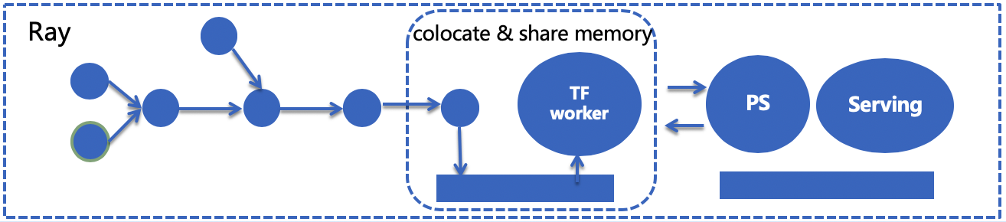
Use Case: Online Machine Learning
3 min, streaming + model training, from feature / label to model output
5 min, streaming + training + serving, from feature / label to model deploy
5% CTR improvement comparing to offline model; 1% CTR improvement comparing to blink solution

Slide 34
Ray API
Functions -> Tasks
def read_array(file):
# read array “a” from “file”
return a
def add(a, b):
return np.add(a, b)

Slide 35
Ray API
Functions -> Tasks
@ray.remote
def read_array(file):
# read array “a” from “file”
return a
@ray.remote
def add(a, b):
return np.add(a, b)

Slide 36
Ray API
Functions -> Tasks
@ray.remote
def read_array(file):
# read array “a” from “file”
return a
@ray.remote
def add(a, b):
return np.add(a, b)
id1 = read_array.remote([5, 5])
read_array
id1

Slide 37
Ray API
Functions -> Tasks
@ray.remote
def read_array(file):
# read array “a” from “file”
return a
@ray.remote
def add(a, b):
return np.add(a, b)
id1 = read_array.remote([5, 5])
id2 = read_array.remote([5, 5])
zeros
zeros
read_array
read_array
id1
id2

Slide 38
Ray API
Functions -> Tasks
@ray.remote
def read_array(file):
# read array “a” from “file”
return a
@ray.remote
def add(a, b):
return np.add(a, b)
id1 = read_array.remote([5, 5])
id2 = read_array.remote([5, 5])
id3 = add.remote(id1, id2)
read_array
read_array
id1
id2
add
id3

Slide 39
Ray API
Functions -> Tasks
@ray.remote
def read_array(file):
# read array “a” from “file”
return a
@ray.remote
def add(a, b):
return np.add(a, b)
id1 = read_array.remote([5, 5])
id2 = read_array.remote([5, 5])
id3 = add.remote(id1, id2)
ray.get(id3)
read_array
read_array
id1
id2
add
id3

Slide 40
Ray API
Functions -> Tasks
@ray.remote
def read_array(file):
# read array “a” from “file”
return a
@ray.remote
def add(a, b):
return np.add(a, b)
id1 = read_array.remote([5, 5])
id2 = read_array.remote([5, 5])
id3 = add.remote(id1, id2)
ray.get(id3)
Classes -> Actors

Slide 41
Ray API
Functions -> Tasks
@ray.remote
def read_array(file):
# read array “a” from “file”
return a
@ray.remote
def add(a, b):
return np.add(a, b)
id1 = read_array.remote([5, 5])
id2 = read_array.remote([5, 5])
id3 = add.remote(id1, id2)
ray.get(id3)
Classes -> Actors
@ray.remote(num_gpus=1)
class Counter(object):
def __init__(self):
self.value = 0
def inc(self):
self.value += 1
return self.value

Slide 42
Ray API
Functions -> Tasks
@ray.remote
def read_array(file):
# read array “a” from “file”
return a
@ray.remote
def add(a, b):
return np.add(a, b)
id1 = read_array.remote([5, 5])
id2 = read_array.remote([5, 5])
id3 = add.remote(id1, id2)
ray.get(id3)
Classes -> Actors
@ray.remote(num_gpus=1)
class Counter(object):
def __init__(self):
self.value = 0
def inc(self):
self.value += 1
return self.value
c = Counter.remote()
id4 = c.inc.remote()
id5 = c.inc.remote()
ray.get([id4, id5])

Slide 43
Parallelism Example: Tree Reduction

Slide 44
Parallelism Example: Tree Reduction
1
2
3
4
5
6
7
8
Add a bunch of values (2 at a time).

Slide 45
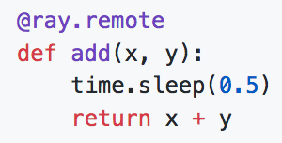
Parallelism Example: Tree Reduction
1
2
3
4
5
6
7
8
Add a bunch of values (2 at a time).

Slide 46
Parallelism Example: Tree Reduction
1
2
3
4
5
6
7
8
add
Add a bunch of values (2 at a time).

Slide 47
Parallelism Example: Tree Reduction
1
2
3
4
5
6
7
8
add
id1
Add a bunch of values (2 at a time).

Slide 48
Parallelism Example: Tree Reduction
1
2
3
4
5
6
7
8
add
id1
add
Add a bunch of values (2 at a time).

Slide 49
Parallelism Example: Tree Reduction
1
2
3
4
5
6
7
8
add
id1
add
id2
Add a bunch of values (2 at a time).

Slide 50
Parallelism Example: Tree Reduction
1
2
3
4
5
6
7
8
add
id1
add
id2
add
Add a bunch of values (2 at a time).

Slide 51
Parallelism Example: Tree Reduction
1
2
3
4
5
6
7
8
add
id1
add
id2
add
id3
Add a bunch of values (2 at a time).

Slide 52
Parallelism Example: Tree Reduction
1
2
3
4
5
6
7
8
add
id1
add
id2
add
id3
add
Add a bunch of values (2 at a time).

Slide 53
Parallelism Example: Tree Reduction
1
2
3
4
5
6
7
8
add
id1
add
id2
add
id3
add
id4
Add a bunch of values (2 at a time).

Slide 54
Parallelism Example: Tree Reduction
1
2
3
4
5
6
7
8
add
id1
add
id2
add
id3
add
id4
add
Add a bunch of values (2 at a time).

Slide 55
Parallelism Example: Tree Reduction
1
2
3
4
5
6
7
8
add
id1
add
id2
add
id3
add
id4
add
id5
Add a bunch of values (2 at a time).

Slide 56
Parallelism Example: Tree Reduction
1
2
3
4
5
6
7
8
add
id1
add
id2
add
id3
add
id4
add
id5
add
Add a bunch of values (2 at a time).

Slide 57
Parallelism Example: Tree Reduction
1
2
3
4
5
6
7
8
add
id1
add
id2
add
id3
add
id4
add
id5
add
Add a bunch of values (2 at a time).
id6

Slide 58
Parallelism Example: Tree Reduction
1
2
3
4
5
6
7
8
add
id1
add
id2
add
id3
add
id4
add
id5
add
Add a bunch of values (2 at a time).
id6
add

Slide 59
Parallelism Example: Tree Reduction
1
2
3
4
5
6
7
8
add
id1
add
id2
add
id3
add
id4
add
id5
add
Add a bunch of values (2 at a time).
id6
add
id7

Slide 60
Parallelism Example: Tree Reduction
1
2
3
4
5
6
7
8
Add a bunch of values (2 at a time).

Slide 61
Parallelism Example: Tree Reduction
1
2
3
4
5
6
7
8
add
add
add
add
Add a bunch of values (2 at a time).

Slide 62
Parallelism Example: Tree Reduction
1
2
3
4
5
6
7
8
add
add
add
add
id1
id2
id3
id4
Add a bunch of values (2 at a time).

Slide 63
Parallelism Example: Tree Reduction
1
2
3
4
5
6
7
8
add
add
add
add
id1
id2
id3
id4
add
add
Add a bunch of values (2 at a time).

Slide 64
Parallelism Example: Tree Reduction
1
2
3
4
5
6
7
8
add
add
add
add
id1
id2
id3
id4
add
add
id5
id6
Add a bunch of values (2 at a time).

Slide 65
Parallelism Example: Tree Reduction
1
2
3
4
5
6
7
8
add
add
add
add
id1
id2
id3
id4
add
add
id5
id6
add
Add a bunch of values (2 at a time).

Slide 66
Parallelism Example: Tree Reduction
1
2
3
4
5
6
7
8
add
add
add
add
id1
id2
id3
id4
add
add
id5
id6
add
id7
Add a bunch of values (2 at a time).

Slide 67
Parallelism Example: Tree Reduction
Add a bunch of values (2 at a time).

Slide 68
Parallelism Example: Tree Reduction
What does the difference look like in code?
Add a bunch of values (2 at a time).

Slide 69
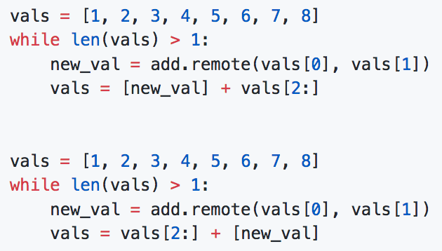
Parallelism Example: Tree Reduction
What does the difference look like in code?
Add a bunch of values (2 at a time).

Slide 70
Parallelism Example: Tree Reduction
What does the difference look like in code?
Add a bunch of values (2 at a time).

Slide 71
Actors: Parameter Server Example
@ray.remote
class ParameterServer(object):
def __init__(self):
self.params = np.zeros(10)
def get_params(self):
return self.params
def update_params(self, grad):
self.params -= grad

Slide 72
Actors: Parameter Server Example
@ray.remote
class ParameterServer(object):
def __init__(self):
self.params = np.zeros(10)
def get_params(self):
return self.params
def update_params(self, grad):
self.params -= grad
@ray.remote(num_gpus=1)
def worker(ps):
while True:
params = ray.get(ps.get_params.remote())
grad = ... # Use TensorFlow
ps.update_params.remote(grad)

Slide 73
Actors: Parameter Server Example
@ray.remote
class ParameterServer(object):
def __init__(self):
self.params = np.zeros(10)
def get_params(self):
return self.params
def update_params(self, grad):
self.params -= grad
@ray.remote(num_gpus=1)
def worker(ps):
while True:
...
@ray.remote(num_gpus=1)
def worker(ps):
while True:
...
@ray.remote(num_gpus=1)
def worker(ps):
while True:
params = ray.get(ps.get_params.remote())
grad = ... # Use TensorFlow
ps.update_params.remote(grad)

Slide 74
Actors: Parameter Server Example
@ray.remote
class ParameterServer(object):
def __init__(self):
self.params = np.zeros(10)
def get_params(self):
return self.params
def update_params(self, grad):
self.params -= grad
@ray.remote(num_gpus=1)
def worker(ps):
while True:
...
@ray.remote
class ParameterServer(object):
def __init__(self):
self.params = np.zeros(10)
def get_params(self):
return self.params
def update_params(self, grad):
self.params -= grad
@ray.remote
class ParameterServer(object):
def __init__(self):
self.params = np.zeros(10)
def get_params(self):
return self.params
def update_params(self, grad):
self.params -= grad
@ray.remote(num_gpus=1)
def worker(ps):
while True:
...
@ray.remote(num_gpus=1)
def worker(ps):
while True:
params = ray.get(ps.get_params.remote())
grad = ... # Use TensorFlow
ps.update_params.remote(grad)

Slide 75
Ray Architecture
Node 1
Node 2
Node 3

Slide 76
Ray Architecture
Node 1
Node 2
Node 3
Driver
Worker
Worker
Worker
Worker
Worker

Slide 77
Ray Architecture
Driver
Worker
Worker
Worker
Worker
Worker
Object Store
Object Store
Object Store

Slide 78
Ray Architecture
Driver
Worker
Worker
Worker
Worker
Worker
Object Store
Object Store
Object Store
Object Manager
Object Manager
Object Manager

Slide 79
Ray Architecture
Driver
Worker
Worker
Worker
Worker
Worker
Object Store
Object Store
Object Store
Raylet
Raylet
Raylet
Object Manager
Object Manager
Object Manager
Scheduler
Scheduler
Scheduler

Slide 80
Ray Architecture
Driver
Worker
Worker
Worker
Worker
Worker
Object Store
Object Store
Object Store
Raylet
Raylet
Raylet
Object Manager
Object Manager
Object Manager
Scheduler
Scheduler
Scheduler
Global Control Store
Debugging Tools
Global Control Store
Global Control Store
Profiling Tools
Web UI

Slide 81
How does this work under the hood?

Slide 82
How does this work under the hood?
Tasks
@ray.remote
def read_array(file):
# read array “a” from “file”
return a
@ray.remote
def add(a, b):
return np.add(a, b)
id1 = read_array.remote([5, 5])
id2 = read_array.remote([5, 5])
id3 = add.remote(id1, id2)
ray.get(id3)
read_array
read_array
id1
id2
add
id3

Slide 83
How does this work under the hood?
read_array
read_array
id1
id2
add
id3

Slide 84
The Ray Architecture
Worker
Worker
Worker
Worker
Worker
Worker
Object Store
Object Store
Object Store
Scheduler
Scheduler
Scheduler
Global Control Store
Global Control Store
Global Control Store

Slide 85
The Ray Architecture
Worker
Worker
Worker
Worker
Worker
Worker
Object Store
Object Store
Object Store
Scheduler
Scheduler
Scheduler
read_array
read_array
Global Control Store
Global Control Store
Global Control Store
id1
id2
add
id3

Slide 86
The Ray Architecture
Worker
Worker
Worker
Worker
Worker
Worker
Object Store
Object Store
Object Store
read_array
read_array
Scheduler
Scheduler
Scheduler
add
read_array
read_array
Global Control Store
Global Control Store
Global Control Store
id1
id2
add
id3

Slide 87
The Ray Architecture
Worker
Worker
Worker
Worker
Worker
Worker
read_array
Object Store
Object Store
Object Store
read_array
Scheduler
Scheduler
Scheduler
add
read_array
read_array
Global Control Store
Global Control Store
Global Control Store
id1
id2
add
id3

Slide 88
The Ray Architecture
Worker
Worker
Worker
Worker
Worker
Worker
read_array
read_array
Object Store
Object Store
Object Store
Scheduler
Scheduler
Scheduler
add
read_array
read_array
Global Control Store
Global Control Store
Global Control Store
id1
id2
add
id3

Slide 89
The Ray Architecture
Worker
Worker
Worker
Worker
Worker
Worker
read_array
read_array
Object Store
Object Store
Object Store
obj1
obj2
Scheduler
Scheduler
Scheduler
add
read_array
read_array
Global Control Store
Global Control Store
Global Control Store
id1
id2
add
id3

Slide 90
The Ray Architecture
Worker
Worker
Worker
Worker
Worker
Worker
Object Store
Object Store
Object Store
obj1
obj2
Scheduler
Scheduler
Scheduler
add
read_array
read_array
Global Control Store
Global Control Store
Global Control Store
id1
id2
add
id3

Slide 91
The Ray Architecture
Worker
Worker
Worker
Worker
Worker
Worker
add
Object Store
Object Store
Object Store
obj1
obj2
Scheduler
Scheduler
Scheduler
read_array
read_array
Global Control Store
Global Control Store
Global Control Store
id1
id2
add
id3

Slide 92
The Ray Architecture
Worker
Worker
Worker
Worker
Worker
Worker
add
Object Store
Object Store
Object Store
obj1
obj2
Scheduler
Scheduler
Scheduler
read_array
read_array
Global Control Store
Global Control Store
Global Control Store
id1
id2
add
id3

Slide 93
The Ray Architecture
Worker
Worker
Worker
Worker
Worker
Worker
add
Object Store
Object Store
Object Store
obj1
obj2
obj2
Scheduler
Scheduler
Scheduler
read_array
read_array
Global Control Store
Global Control Store
Global Control Store
id1
id2
add
id3

Slide 94
The Ray Architecture
Worker
Worker
Worker
Worker
Worker
Worker
add
Object Store
Object Store
Object Store
obj1
obj2
obj2
Scheduler
Scheduler
Scheduler
read_array
read_array
Global Control Store
Global Control Store
Global Control Store
id1
id2
add
id3

Slide 95
The Ray Architecture
Worker
Worker
Worker
Worker
Worker
Worker
add
Object Store
Object Store
Object Store
obj1
obj3
obj2
obj2
Scheduler
Scheduler
Scheduler
read_array
read_array
Global Control Store
Global Control Store
Global Control Store
id1
id2
add
id3

Slide 96
The Ray Architecture
Worker
Worker
Worker
Worker
Worker
Worker
add
Object Store
Object Store
Object Store
obj1
obj3
obj2
obj2
Scheduler
Scheduler
Scheduler
read_array
read_array
Global Control Store
Global Control Store
Global Control Store
id1
id2
read_array
read_array
add
id1
id2
id3

Slide 97
Conclusion
Ray is an open source project for distributed computing
special-purpose distributed systems -> general-purpose distributed system
Support for the full ML lifecycle (data collection, training, simulation, serving)
github.com/ray-project/ray

